Slide 1
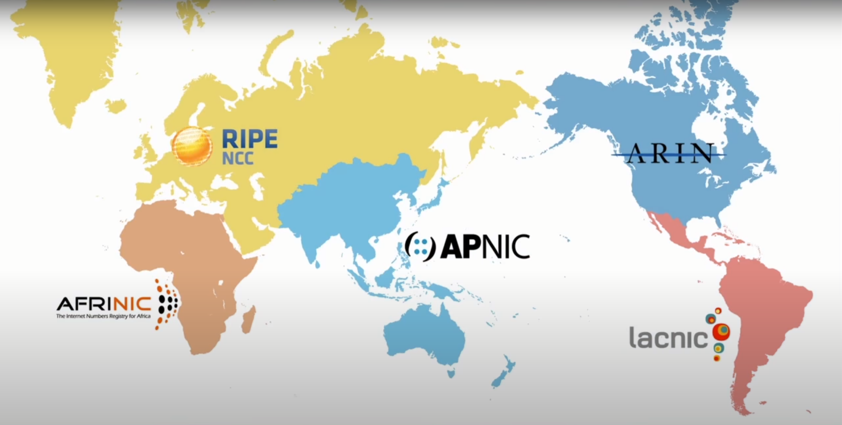

Regional Internet Registries (RIRs)
RFC2050 (1996)
A Regional Internet Registry (RIR) manages the allocation and registration of Internet number resources in a particular region of the world and maintains a unique registry of all IP numbers issued.
(1996)
(InterNIC, 1996)
(1996)
(2005)
(2002)
Each RIR received its last /8 IPv4 address block from IANA on 3 February 2011
Coordinating body for 5 RIRs

Slide 2
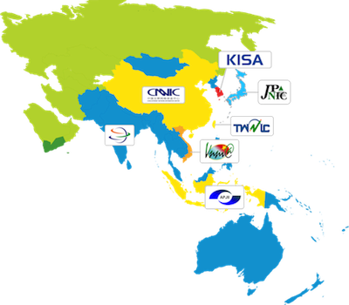
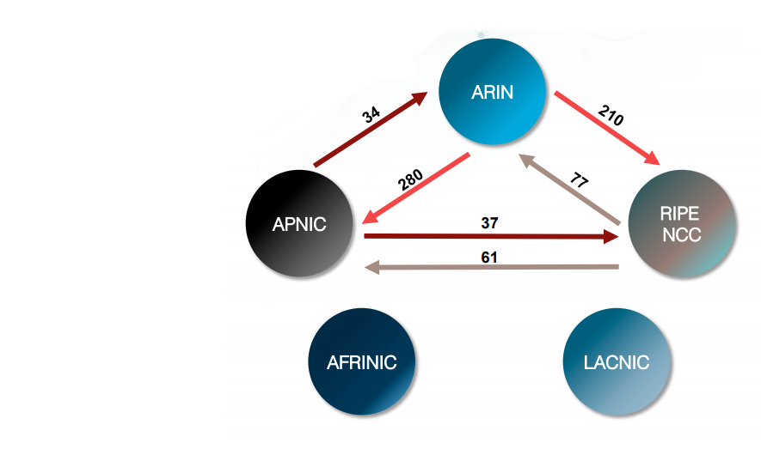
National Internet Registries (RIRs)

Slide 3
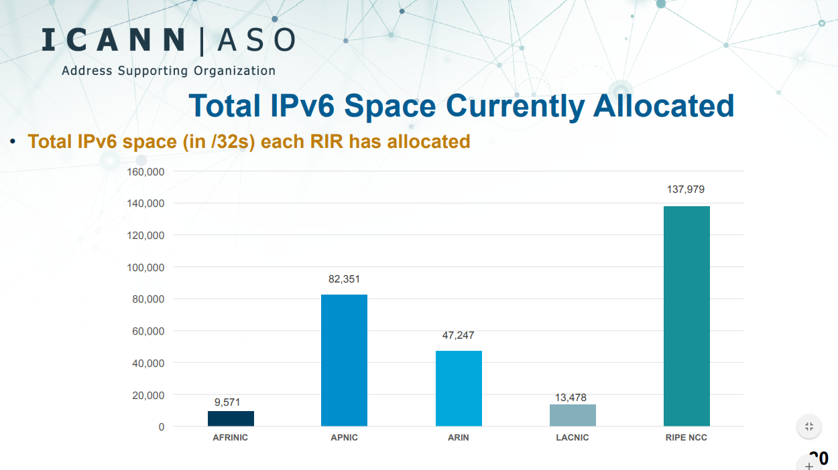

Slide 4
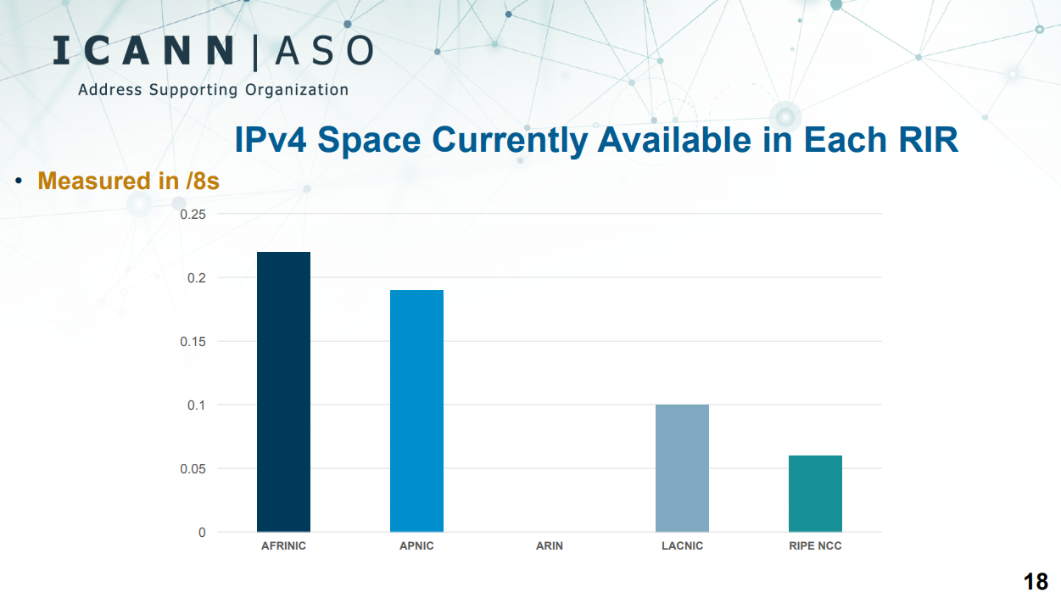

Slide 6
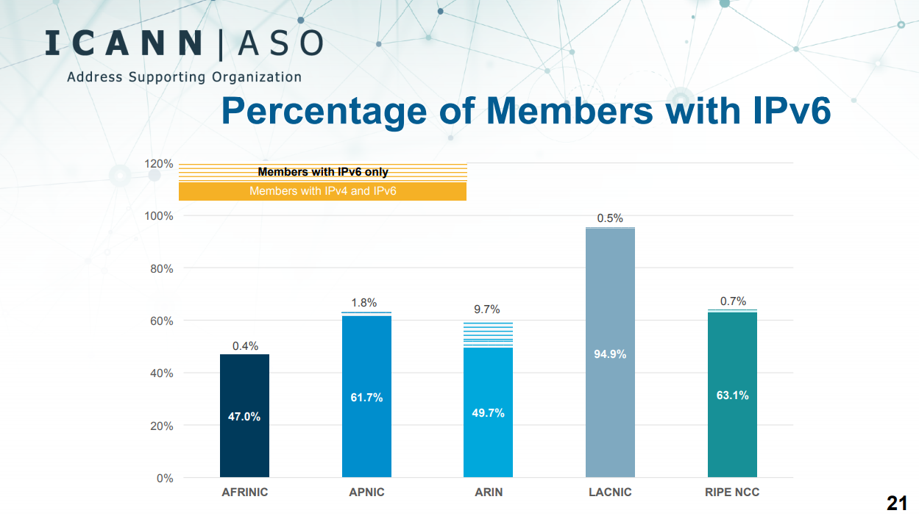

Slide 7
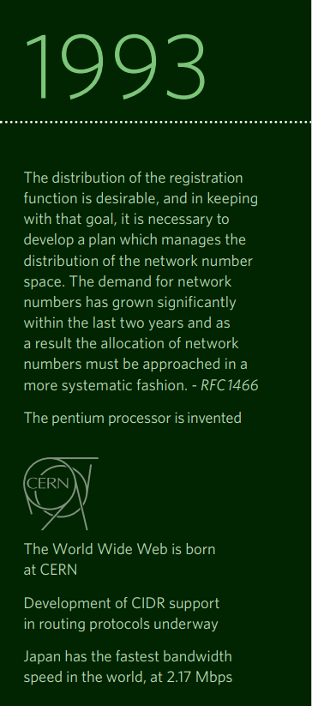
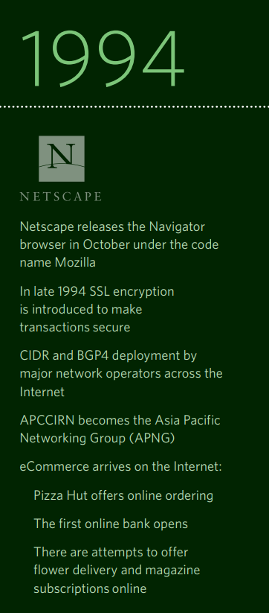
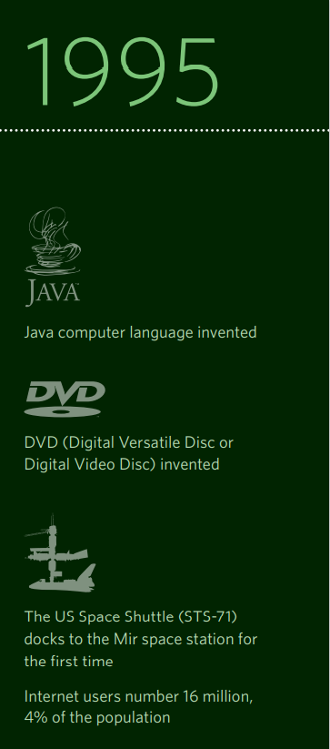
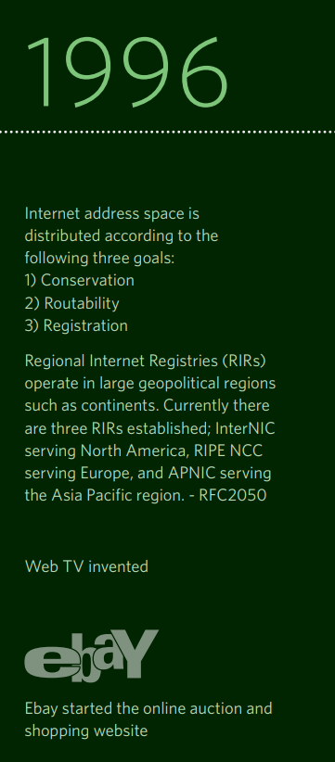

M: 0 ASN: 0 IPv4: 405 IPv6: 0 S: 1
M: 27 ASN: 1 IPv4: 513 IPv6: 0 S: 2
M: 55 ASN: 47 IPv4: 993 IPv6: 0 S: 3
M: 114 ASN: 63 IPv4: 1050 IPv6: 0 S: 5

Slide 8

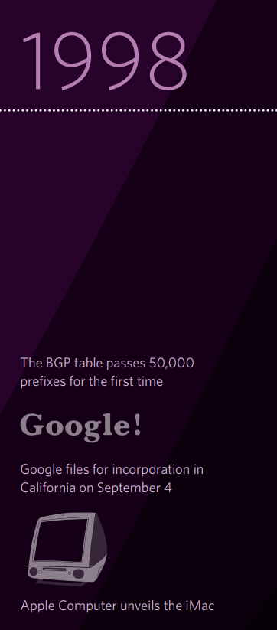

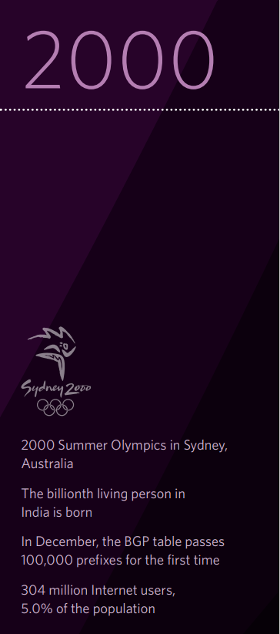
M: 200 ASN: 98 IPv4: 274 IPv6: 0 S: 5
M: 249 ASN: 108 IPv4: 166 IPv6: 0 S: 6
M: 396 ASN: 128 IPv4: 232 IPv6: 5 S: 12
M: 602 ASN: 230 IPv4: 353 IPv6: 14 S: 23

Slide 9
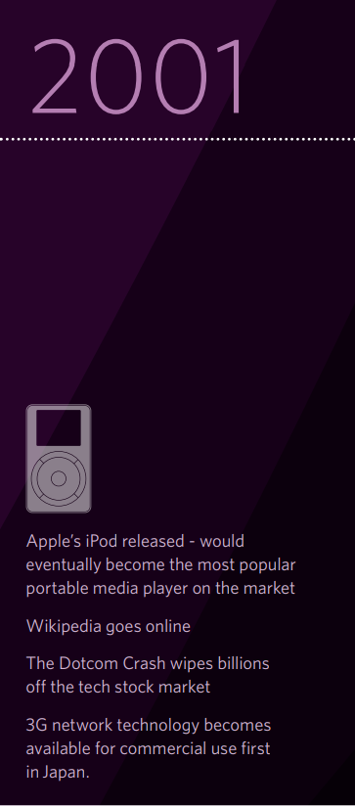
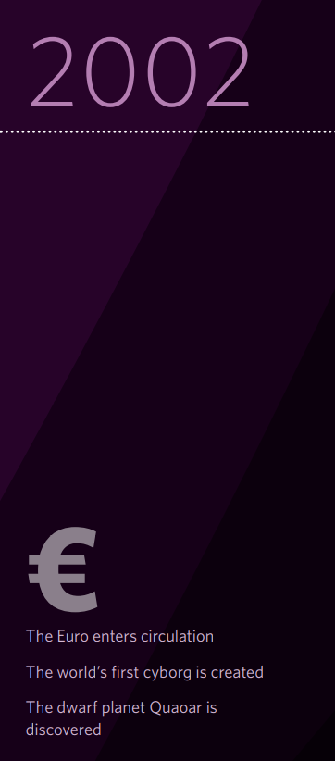
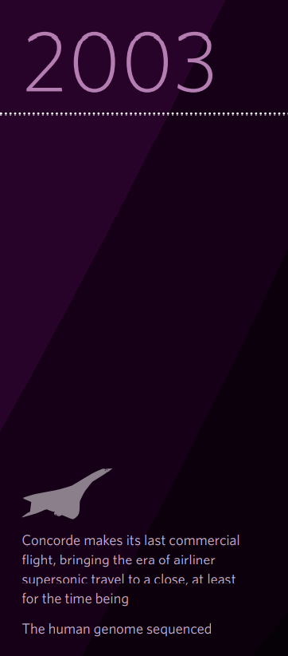
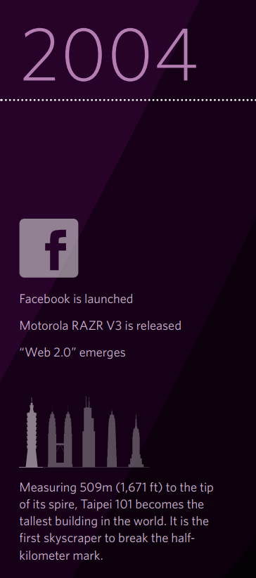
M: 699 ASN: 220 IPv4: 360 IPv6: 25 S: 31
M: 767 ASN: 203 IPv4: 301 IPv6: 86 S: 33
M: 879 ASN: 198 IPv4: 422 IPv6: 50 S: 40
M: 978 ASN: 186 IPv4: 568 IPv6: 57 S: 44

Slide 10
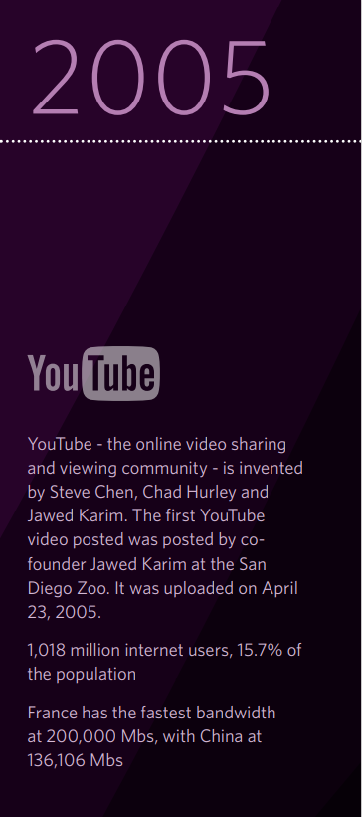
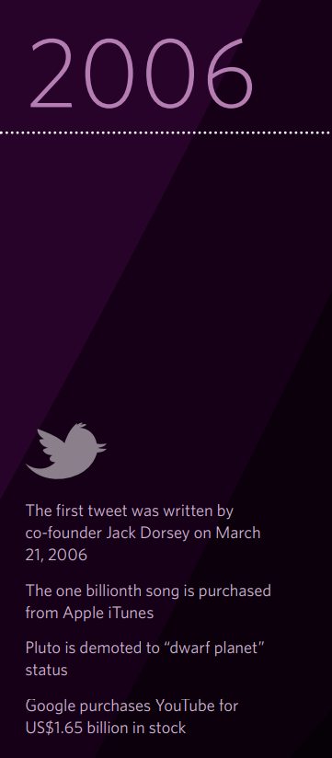

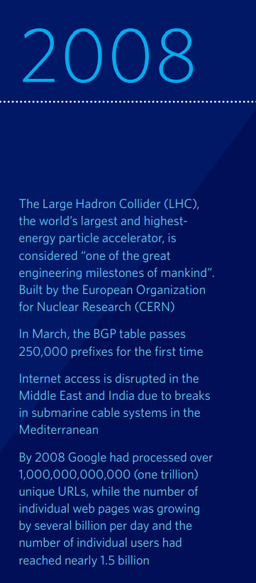
M: 1157 ASN: 245 IPv4: 705 IPv6: 51 S: 46
M: 1362 ASN: 298 IPv4: 864 IPv6: 42 S: 46
M: 1584 ASN: 308 IPv4: 917 IPv6: 63 S: 57
M: 1855 ASN: 418 IPv4: 984 IPv6: 160 S: 62

Slide 11
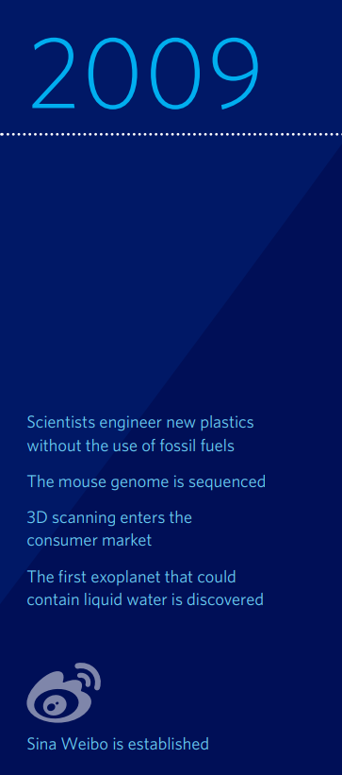
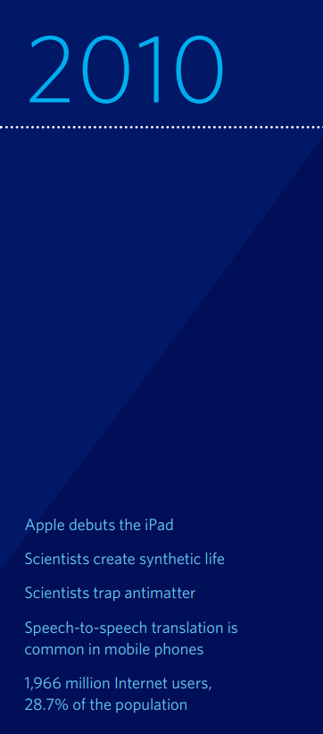
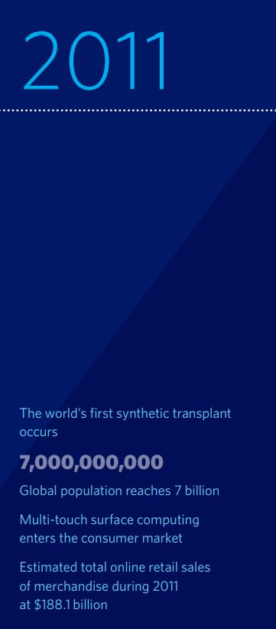
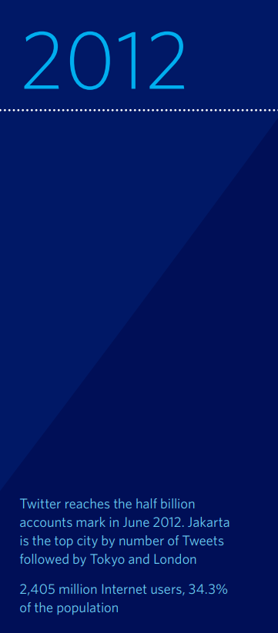
M: 2170 ASN: 436 IPv4: 1065 IPv6: 185 S: 63
M: 2521 ASN: 505 IPv4: 1358 IPv6: 643 S: 65
M: 2947 ASN: 495 IPv4: 1475 IPv6: 620 S: 70
M: 3534 ASN: 581 IPv4: 1075 IPv6: 562 S: 71
Each RIR received its last /8 IPv4 address block from IANA on 3 February 2011

Slide 12
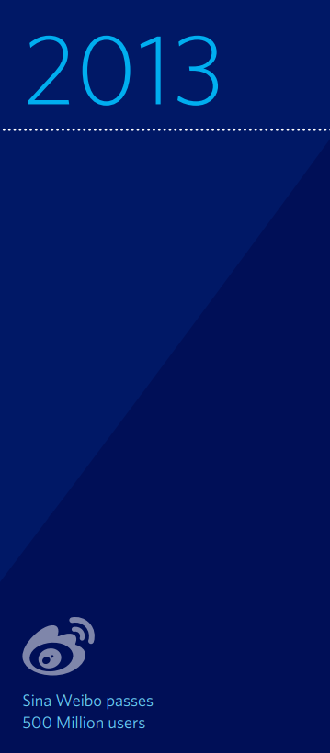
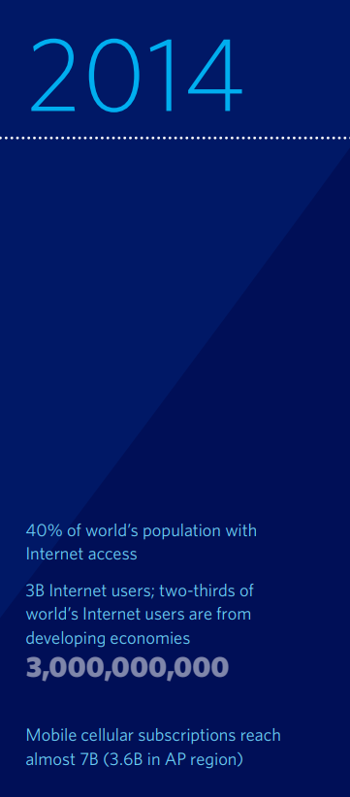
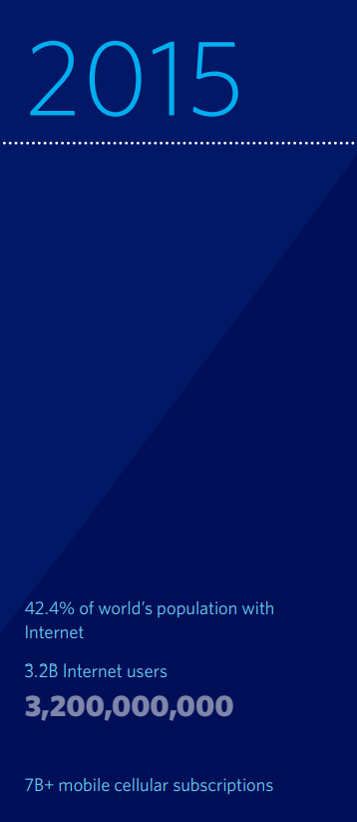
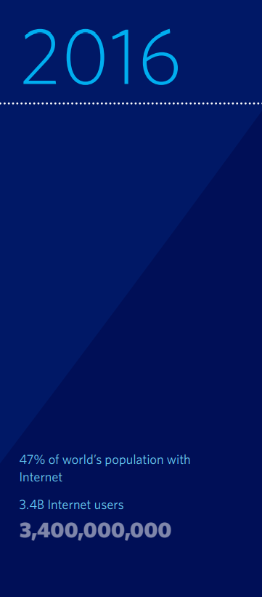
M: 3779 ASN: 306 IPv4: 744 IPv6: 255 S: 68
M: 4051 ASN: 646 IPv4: 3914 IPv6: 484 S: 70
M: 5268 ASN: 881 IPv4: 4498 IPv6: 785 S: 76
M: 5994 ASN: 881 IPv4: 4498 IPv6: 785 S: 75

Slide 13
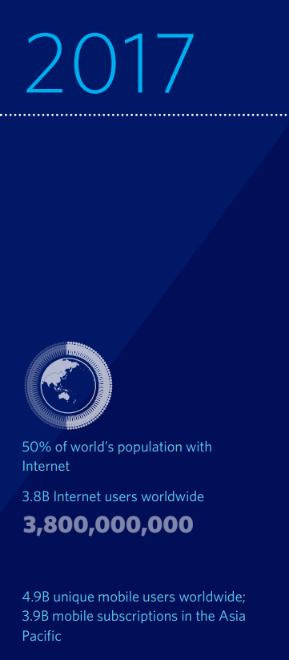
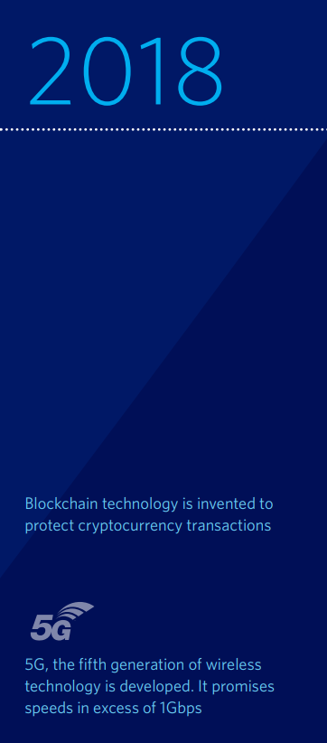

M: 6557 ASN: 1226 IPv4: 2235 IPv6: 1377 S: 77
M: 7162 ASN: 912 IPv4: 2199 IPv6: 1430 S: 80
M: 7776 ASN: 1560 IPv4: 2027 IPv6: 1472 S: 77
IPv6 adoption increased, with the proportion of Members holding IPv6 resources reaching 61% and total IPv6 capability reaching 22%

